Slide 1
Code Review with VS 2012

Slide 2
Agenda
What is Code review?
Run Code analysis in VS 2012
Configuring Code Analysis rule set
Q&A

Slide 3
What is Code review?
A code review is the process of examining written code with the purpose of highlighting mistakes, include bugs and design errors, before the code becomes part of the product.
Code review should be carried out regularly during the code design phase.

Slide 4
Types of Code review
Static code review: code is analyzed for mistakes and syntax errors on programming rules and guidelines of the project.
Dynamic code review: code is executed to compare the actual results with the expected results.
Notes:
Một số đoạn code ko gây ra lỗi, ví dụ vẫn tuân thủ quy tắc của Microsoft, nhưng nó không theo guidelines, rules of dự án, cũng được xem là error.
Dynamic code review: Trong khi làm code review, developers có thể chạy hoặc debug chương trình, để kiểm tra đoạn code có chạy theo đúng logic của chương trình hay ko, hoặc developers sẽ phát hiện ra những lỗi ko mong đợi(unexpected errors) của chương trình.

Slide 5
Other benefits of Code review
Code is also reviewed for security, maintainability, reliability, upgradability, flexibility, integration capability, and other features during the code review process.
Code review is to make sure that code on an enterprise is consistent in all projects.
Code review enables transitions and turnovers' of projects to go smoothly since every member of the team understands the code.
Notes:
Transitions and turnovers: Code review cũng giúp cho người review - team lead hiểu đc ý nghĩa của những đoạn code được viết bởi developers khác.
Nắm được sự thay đổi và khả năng impact đến những modules khác. Do vậy, khi application có lỗi, dễ dàng dự đoán được lỗi đó có khả năng xảy ra ở những modules nào, functions nào.

Slide 6
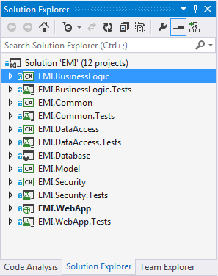
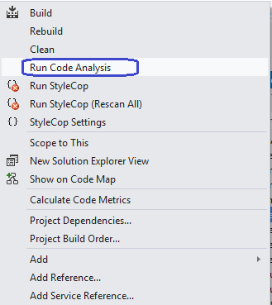
Run Code analysis in VS 2012
In Solution Explorer, right-click on a project, then click on “Run Code Analysis”
Notes:
PHUOCNT1: Công cụ phân tích code của VS 2012

Slide 7
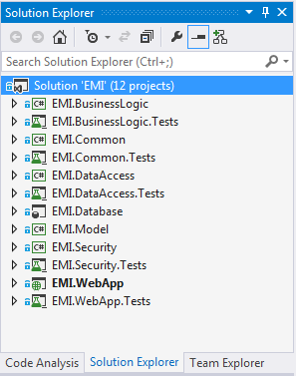
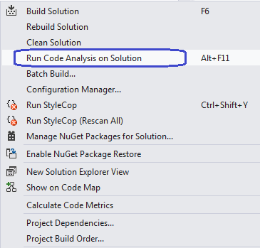
Run Code analysis in VS 2012(cont.)
Or we can right-click on the solution, then click on “Run Code Analysis on Solution” to analyze for all projects.

Slide 8
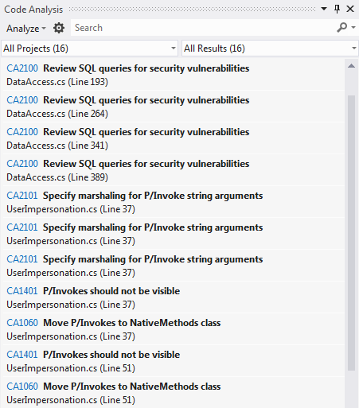
Run Code analysis in VS 2012(cont.)
The Code Analysis window will be shown with all warnings on code review.
We can also go to menu View|Other windows|Code Analysis to turn it on.

Slide 9
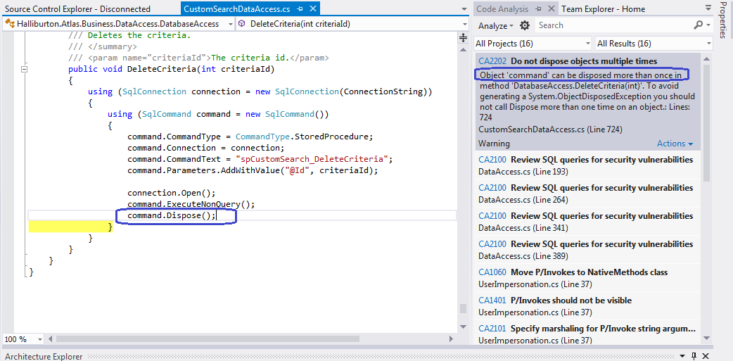
Run Code analysis in VS 2012(cont.)
Click on 1 item in Code Analysis, source code will be shown. The instruction is also show how to fix it.

Slide 10
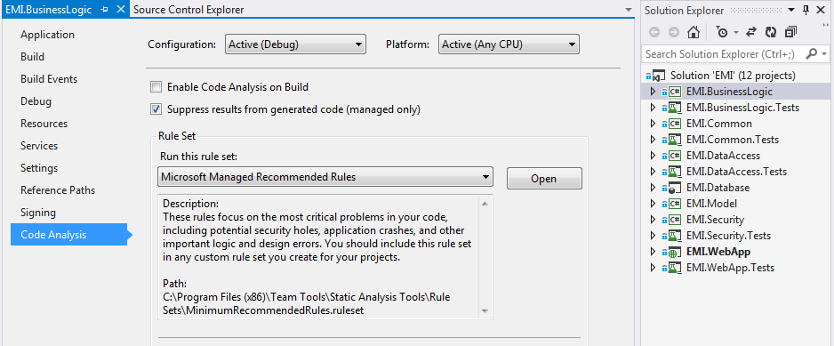
Configuring Code Analysis rule set
Configuring for a project: right-click on the project, select Property. Property window is shown on the left, select Code Analysis:
Notes:
PHUOCNT1: Tùy biến các RULE cho từng dự án.

Slide 11
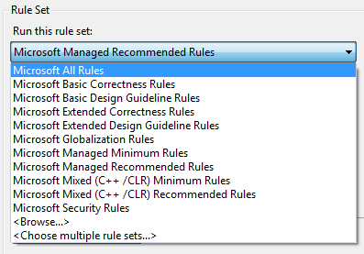
Configuring Code Analysis rule set(cont.)
Select the “Microsoft All Rules” option for combination of all rule sets.

Slide 12
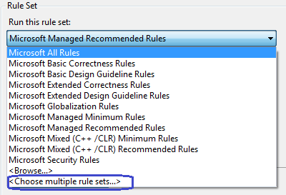
Configuring Code Analysis rule set(cont.)
Select the “Choose multiple rule sets…” option for combination of some rule sets.

Slide 13
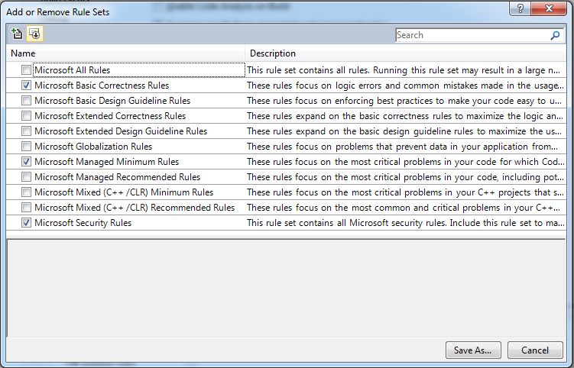
Configuring Code Analysis rule set(cont.)
Choose some rule sets to combine. Click Save As to save into a file.

Slide 14
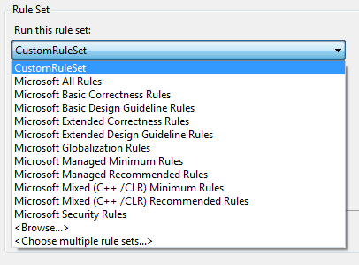
Configuring Code Analysis rule set(cont.)
The Rule Set list is added 1 more custom rule.

Slide 15
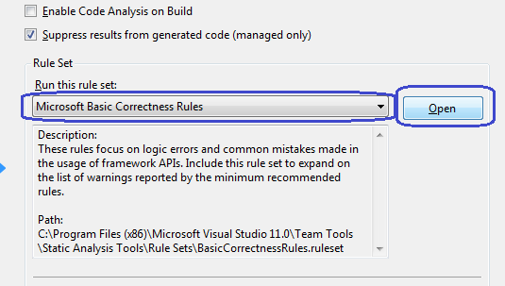
Configuring Code Analysis rule set(cont.)
Custom detail for a rule set:
Select 1 rule set in the list, then click on Open button:

Slide 16
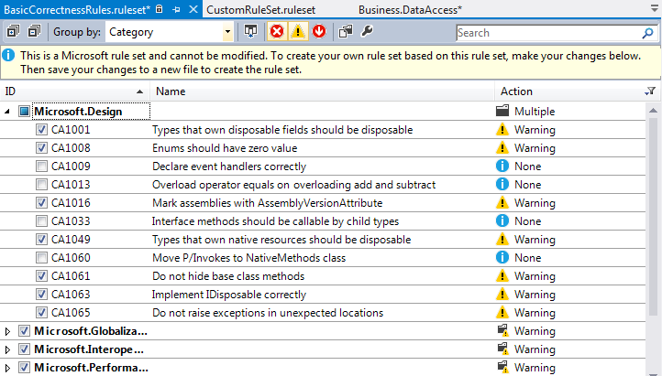
Configuring Code Analysis rule set(cont.)
All the single rules are default selected. We can unselect some rules. Then click on menu Save to save this setting to a custom rule.

Slide 17
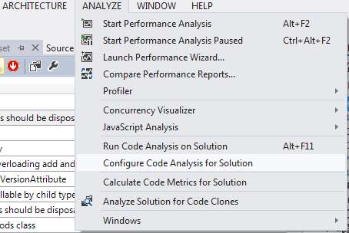
Configuring Code Analysis rule set(cont.)
Configure Code Analysis for the solution.

Slide 18
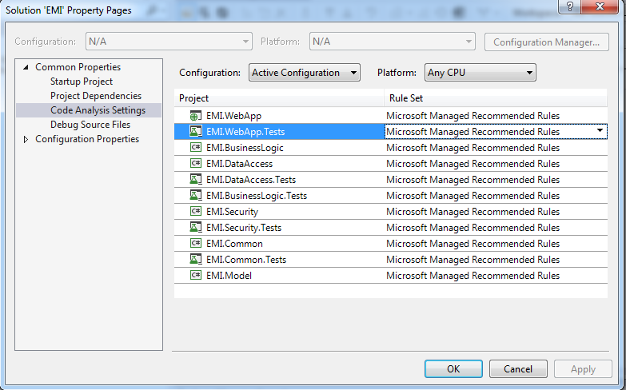
Configuring Code Analysis rule set(cont.)
Select/change rules for each project

Slide 19
References
Pro C# 5.0 and the .NET 4.5 Framework by Andrew Troelsen
Notes:
PHUOCNT1: Xem lại tài liệu tham khảo.

Slide 20
Question & Answer
Notes:
http://msdn.microsoft.com/en-us/data/dd363565.aspx

